Slide 1

MALLA REDDY COLLEGE OF ENGINEERING & TECHNOLOGY (Autonomous Institution – UGC, Govt. of India) DEPARTMENT OF COMPUTER SCIENCE AND ENGINEERING
RAINFALL PREDICTION SYSTEM USING MACHINE LEARNING AND DEEP LEARNING
Batch No : 16
K.Sultan Salauddin – 20N31A05B2
K.Gayatri – 20N31A0598
G.Sai Deep – 20N31A0577
Under the Guidance of Dr.N.Sathish Kumar
Associate Professor

Slide 2
AGENDA
Introduction
Abstract
Existing System
Proposed System
Software and Hardware Requirements
Literature Survey
System Architecture
UML Diagrams
Algorithms and Technologies
Output Screens and Results
Conclusion
Future Scope

Slide 3
Introduction
Rainfall has a major impact on how the plants and fauna of the natural world evolve.Its significance must be taken into account by all living things, including humans, animals, and plants.
Even though rain is good for agriculture, heavy showers can damage crops.Flooding, which poses a threat to human life and causes infrastructure and building damage.
Due to the significant climate changes, it is now harder than ever to estimate rainfall accurately.
Predicting the amount of rain is one of the more challenging parts of weather forecasting.

Slide 4
Abstract
Forecasting the amount of rain that will fall each day increases agricultural productivity and guarantees a steady supply of food and water to keep populations healthy. Numerous experiments have been conducted in different countries to forecast rainfall using machine learning and data mining techniques.The agriculture, which is the foundation of the nation's economy, is impacted by the country's uneven rainfall distribution. The nation must plan for and carry out the prudent use of rainfall water in order to mitigate the problems of flooding and drought.This study's primary goal is to determine the pertinent atmospheric factors that contribute to precipitation and utilize artificial intelligence to forecast the daily amount of rain that will fall. The machine learning model's input variables were chosen using the Pearson correlation technique to be pertinent environmental factors. The root mean squared error and mean absolute error methodologies are used to assess the performance of the machine learning model. The study's findings show that the Extreme Gradient Boosting machine learning technique performs better than its rivals.. We accomplish this using the machine learning methods of Extreme Gradient Boost, Random Forest, and Multivariate Linear Regression.

Slide 5
Existing System
Logistic Regression :
A classification process known as logistic regression is employed to calculate the likelihood of an event occurring based on logistic function. When the dependent variable has only two possible values, such as 0 and 1 or True and False. The Logistic Regression model generates a coefficient that estimates the relative influence of the independent variable on the dependent variable.
K -Nearest Neighbor :
Instance-based learning, often known as lazy learning, is the category in which the K-Nearest Neighbors (K-NN) method belongs. Although It is workable for regression, classification is where it is most frequently utilized. The K-NN technique has a number of advantages, including being straightforward, simple to use, and easy to comprehend. It also offers good accuracy for smaller datasets. Yet it can be expensive to compute, especially for larger datasets., and it might not work well if the dataset is unbalanced.

Slide 6
Support Vector Machine (SVM) :
Machine learning uses the support vector machine (SVM) method as a classification tool. It is a binary linear classifier that distinguishes between the various classes of data by identifying the ideal border, or hyperplane. The SVM's goal is to maximize the distance between the nearest datapoints in each class and the hyperplane, which separates the two classes' data points. SVM is a potent algorithm that is frequently employed when high accuracy classification in complex datasets is required. The SVM technique has a number of benefits, including the capacity to handle big datasets, low-dimensional data, and non-linear data by applying kernel approaches.

Slide 7
Proposed System
Extreme Gradient Boosting :
XGBoost is a supervised machine learning algorithm that belongs to the boosting algorithm family. It is an optimized version of the gradient boosting algorithm, whose goal is to make the model faster and more accurate by shortening the time required to calculate the gradient. Due to its prowess in managing big datasets, high accuracy, and handling missing values, XGBoost has become quite well-liked in the data science field. Decision trees, which are weak learners, are systematically added to the model as part of the process, with each new tree being trained to rectify the mistakes produced by its predecessors. To put it another way, XGBoost creates a collection of decision trees, where each tree aims to identify the patterns in the data that were missed by the previous trees.

Slide 8
Random Forest :
An approach for ensemble learning called RF is utilized to solve classification and regression issues. A final prediction is made by combining the results of many decision trees created by this supervised learning technique.A forest of decision trees is created using Random Forest, and each tree is trained using a random subset of the training data and the features. This lessens overfitting and enhances generalization ability. The user can alter two hyperparameters: the size of the subgroups and the number of trees in the forest. Each decision tree in the forest makes a separate prediction about the class or value of the new data point during prediction. The final forecast is then made by averaging or taking the majority vote (for classification) from all of the decision trees' outputs.

Slide 9
Hardware and Software Requirements
Hardware Requirements :
System : Intel Core
Hard Disk : 500 GB.
Floppy Drive : 1.44 MB.
Monitor : 14 Colour Monitor.
Mouse : Optical Mouse.
RAM : 2 GB

Slide 10
Software Requirements :
Operating System : Windows 11
System Coding : Python
Tool : Jupiter Notebook
Libraries : Pandas,Numpy,Matplotlib,Scikit-Learn,etc,…

Slide 11
Literature Survey
Sl.No | Author(s) & Journal Details | Title of the Paper | Outcome
1. | Kunverji | Indian Water Portal | 94.4%
2. | Rani | Flood Detection | 80.7%
3. | Tehrany | Malaysian Flood Monitoring Model | 85.9%

Slide 12
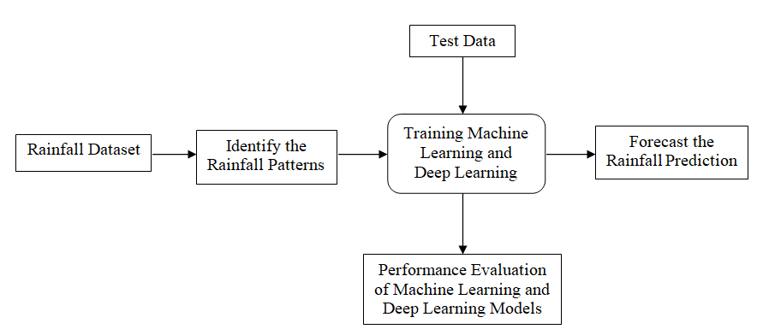
System Architecture
Fig : System Architecture of Rainfall Prediction

Slide 13
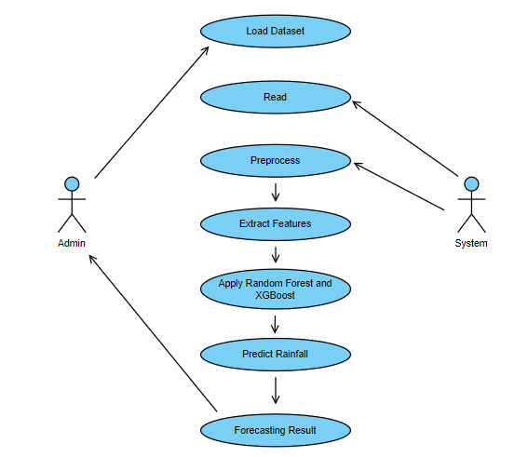
UML Diagrams
Use Case Diagram :
Fig : Use Case Diagram

Slide 14
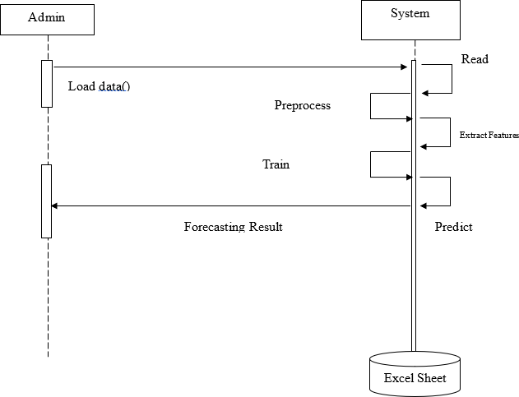
Sequence Diagram :
Fig : Sequence Diagram

Slide 15
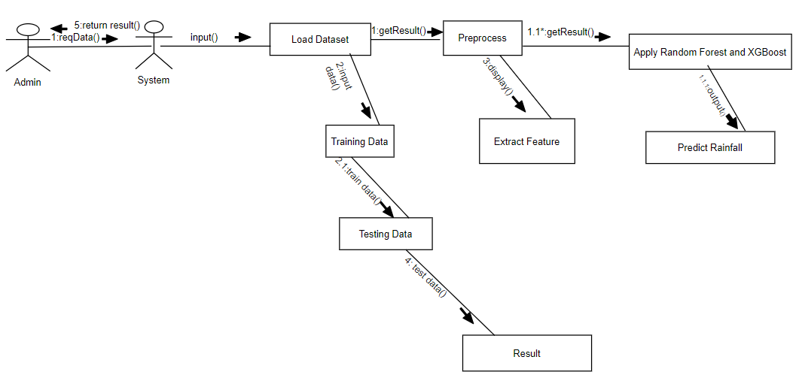
Collaboration Diagram :
Fig : Collaboration Diagram

Slide 16
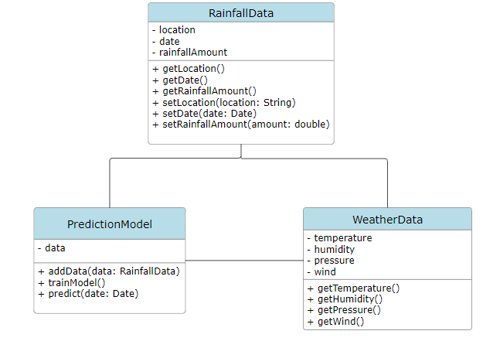
Class Diagram :
Fig : Class Diagram

Slide 17
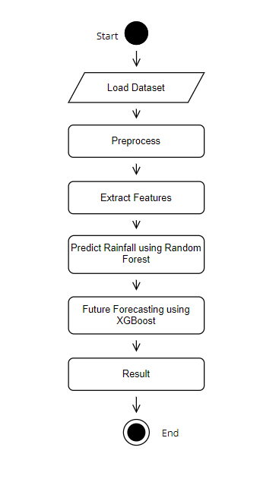
Activity Diagram :
Fig : Activity Diagram

Slide 18
Algorithms and Technologies
Algorithms
Logistic Regression :
Logistic regression is one of the most popular Machine Learning algorithms, which comes under the Supervised Learning technique. It is used for predicting the categorical dependent variable using a given set of independent variables.Logistic regression predicts the output of a categorical dependent variable. Therefore the outcome must be a categorical or discrete value. It can be either Yes or No, 0 or 1, true or False.
Decision Tree :
Decision Tree is a Supervised learning technique that can be used for both classification and Regression problems, but mostly it is preferred for solving Classification problems. There are two nodes, which are the Decision Node and Leaf Node. Decision nodes are used to make any decision and have multiple branches, whereas Leaf nodes are the output of those decisions and do not contain any further branches.The decisions or the test are performed on the basis of features of the given dataset.

Slide 19
Artificial Neural Network :
The Artificial Neural Network Tutorial covers both fundamental and sophisticated ANN principles. an artificial neural network is a computational network that is modeled after the biological neural networks that give the human brain its structure. Artificial neural networks feature neurons that are connected to one another at different layers of the network, just as neurons in a real brain.These neurons are known as nodes.
Random Forest :
Among the supervised learning methods is the well-known machine learning algorithm Random Forest. It can be used for machine learning problems that involve regression and classification. Its basis is the concept of ensemble learning, which is the act of combining multiple classifiers to improve the functionality of the model and solve a difficult problem. A final prediction is made by combining the results of many decision trees created by this supervised learning technique.

Slide 20
XG Boost :
XGBoost is a supervised machine learning algorithm that belongs to the boosting algorithm family. It is an optimized version of the gradient boosting algorithm, whose goal is to make the model faster and more accurate by shortening the time required to calculate the gradient. Due to its prowess in managing big datasets, high accuracy, and handling missing values, XGBoost has become quite well-liked in the data science field. XGBoost creates a collection of decision trees, where each tree aims to identify the patterns in the data that were missed by the previous trees.

Slide 21
Technologies
Python :
Python is a high-level, general-purpose programming language. Its design philosophy emphasizes code readability with the
use of significant indentation. Python is dynamically typed and garbage-collected. It supports multiple programming paradigms, including structured (particularly procedural), object-oriented and functional programming.
Anaconda Navigator :
Anaconda Navigator is a desktop graphical user interface (GUI) included in Anaconda® Distribution that allows you to launch
applications and manage conda packages, environments, and channels without using command line interface (CLI) commands.
Navigator can search for packages on Anaconda.org or in a local Anaconda Repository. It is available for Windows, macOS, and
Linux.

Slide 22
Pandas :
Pandas is a software library written for the Python programming language for data manipulation and analysis. In particular, it offers data structures and operations for manipulating numerical tables and time series. This library helps to load the data frame in a 2D array format and has multiple functions to perform analysis tasks in one go.
NumPy :
NumPy is a library for the Python programming language, adding support for large, multi-dimensional arrays and matrices, along with a large collection of high-level mathematical functions to operate on these arrays. Numpy arrays are very fast and can perform large computations in a very short time.

Slide 23
Sklearn :
scikit-learn (formerly scikits.learn and also known as sklearn) is a free software machine learning library for the Python programming language.It features various classification, regression and clustering algorithms including support-vector machines, random forests, gradient boosting. We will use Scikit-learn's to train our dataset. Once the model is trained, we can give our own inputs for the various columns such as temperature, dew point, pressure, etc. to predict the weather based on these attributes.
Pickle :
The pickle module implements binary protocols for serializing and de-serializing a Python object structure. The pickle module can be used for serializing and deserializing Python objects. Here's how pickle could be useful in such a system as model persistence and data persistence.

Slide 24
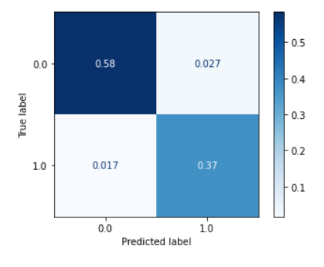
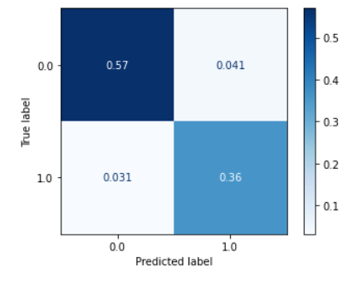
Output Screens and Results
Output Screens :
Fig : Confusion Matrix for Random Forest
Fig : Confusion Matrix for XG Boost

Slide 25
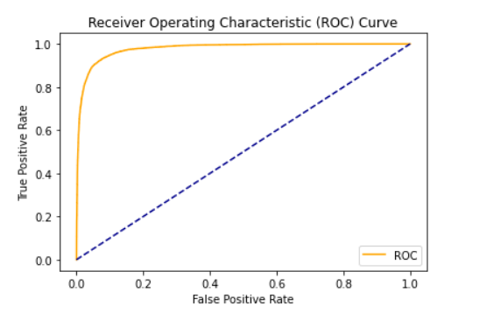
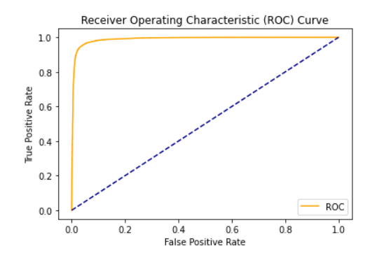
ROC of Random Forest
ROC of XG Boost

Slide 26
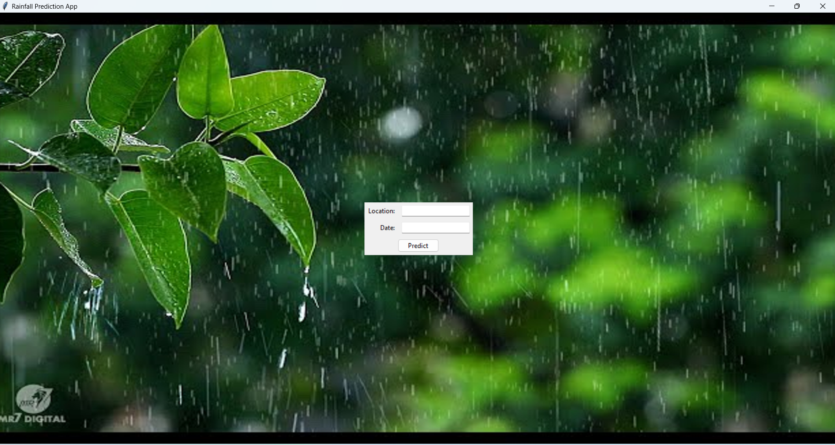
Fig : Home Screen

Slide 27

Fig : Rainy Day

Slide 28
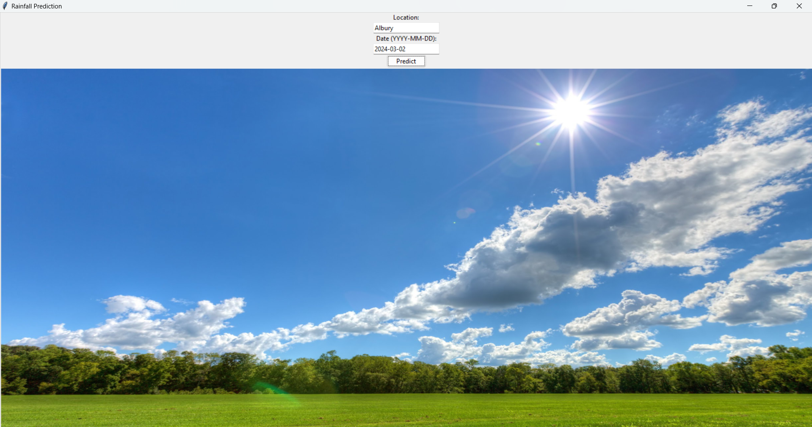
Fig : Sunny Day

Slide 29
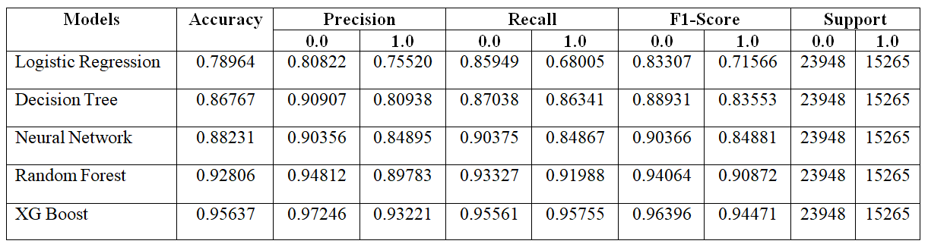
Results :
Table : Model Evaluation

Slide 30
Conclusion
Machine learning and data science are employed in the application area of rainfall prediction to foretell atmospheric conditions. Predicting rainfall intensity is crucial for efficient water usage, crop production, and the reduction of rain-related disease and food-related death.
The input variables for the machine learning model utilized in this paper were the chosen features. The XGBoost algorithm was discovered to be a more effective machine learning method for daily rainfall amount prediction utilizing specified environmental parameters when results from the two algorithms (RF and XGBoost) were compared.

Slide 31
Future Scope
In the future, this project can be enhanced by
• Improving the model’s accuracy by hyper parameter tuning.
• By deploying into end-to-end application.
• Predicting with live dataset.
More changes & ideas can be adapted such as integrating the system with a flood prediction and alert model pertaining to the rivers. The system can also include another prediction model to predict whether it will rain tomorrow or not based on weather data for that particular day in major cities. Additional Features such as real time updates & major alerts around the country can be displayed on the website for precautionary measures.

Slide 32
THANK YOU

